Slide 1
Stock Market Prediction Using Machine Learning

Slide 2
Contents
Motivation
Introduction
Problem Statement
State of Art
System Diagrams
Proposed Algorithm
Requiremets
Results
Advantages and Limitations
Conclusion
Future Work

Slide 3
Motivation
High volume of general public are loosing money in stock markets due to insufficient research
Higher inflation rate and lower interest rate
There are lots of contradicting opinions in the news
A system that could predict the stock prices accurately is highly in demand

Slide 4
Introduction
Stock Market is the aggregation of buyers and sellers of the shares of listed companies
The share prices of companies fluctuate according to the companies performance and quarterly profits/losses
Buying shares in a good company is a profitable investment and it can yield higher yields than FDs

Slide 5
“The stock market is filled with individuals who know the price of everything, but the value of nothing.”
-Phillip Fisher

Slide 6
Problem Statement
To predict the share price of companies using 5 different Machine Learning Algorithms and measure the accuracy of each Algorithm
Algorithms are:
SVM (Support Vector Machine)
Radial Basis function
Single level perceptron
Multi level perceptron
Fbprophet

Slide 7
State of Art
S.No | Paper Title | Summary | Advantages | Disadvantages
1 | Comparative analysis of data mining techniques for financial data using parallel processing [2014][IEEE] | Do the comparative analysis of several data mining classification techniques on the basis of parameters accuracy, execution time, types of datasets and applications. | Simple Regression and multivariate analysis used, Regression analysis on attributes is used | No use of machine learning. Does not provide the algorithm used.
2 | Stock market prices do not follow random walks: Evidence from a simple specification test [2015][IEEE] | Test the random walk hypothesis for weekly stock market returns by comparing variance estimators derived from data sampled at different frequencies | Simple trading rules extraction and Extraction of Trading Rules from Charts and Trading Rules | No alternative provided for human investing. Show only the flaws on manual investments.
3 | A Machine Learning Model for Stock Market Prediction [2017][IJAERD] | Support Vector Machine with Regression Technology (SVR), Recurrent Neural networks(RNN) | Regression analysis on attributes using simple Regression and multivariate analysis used | It is not tested in real market. Shows how social media affects share prices. Does not account for other factors.

Slide 8
State of Art
S.No | Paper Title | Summary | Advantages | Disadvantages
4 | Twitter mood predicts the stock market [2010][IEEE] | Analyze the text content of daily Twitter feeds by two mood tracking tools, namely OpinionFinder that measures positive vs. negative mood and Google-Proﬁle of Mood States | These results are strongly indicative of a predictive correlation between measurements of the public mood states from Twitter feeds | Difficult to scan each every text extraction from large set of data, difficult Text mining
5 | Stock Market Prediction on High-Frequency Data Using Generative Adversarial Nets [2017][Research] | Propose a generic framework employing Long Short-Term Memory (LSTM) and convolutional neural network(CNN)for adversarial training to forecast high frequency stock market | This model achieves prediction ability superior to other benchmark methods by means of adversarial training, minimizing direction prediction loss, and forecast error loss | Can’t predict Multi scale Conditions and live data
6 | Stock Market Prediction Using Machine Learning [2017][IJAERD] | Uses different modules and give different models and give best accuracy using live streaming data. | Predict Real Market Data and calculate Live data using single and multilevel perspective, SVM , Radial Bias | Couldn’t work Textual Data form different Browsing Data (Web Crawling)

Slide 9
System Diagrams

Slide 10
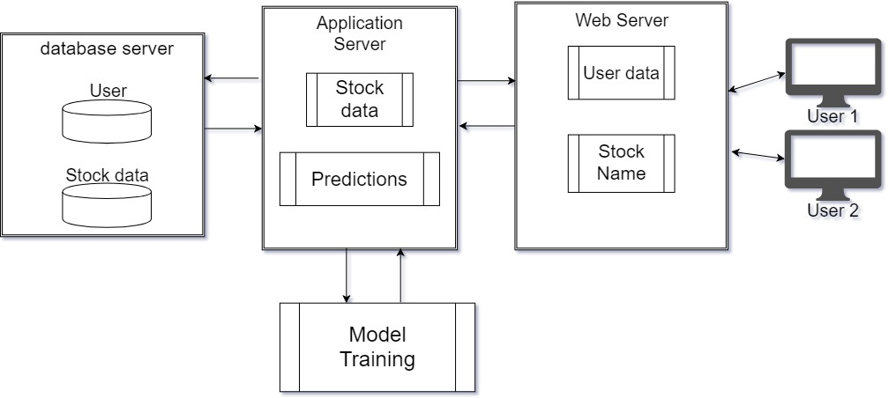
System Architecture

Slide 11
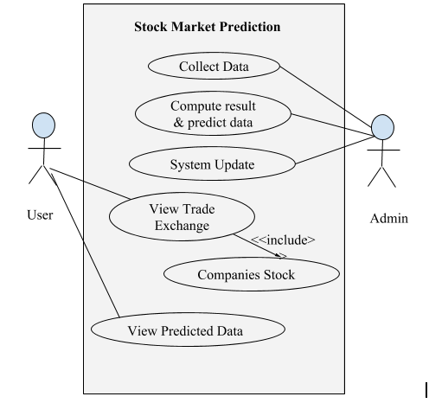
Use Case Diagram

Slide 12
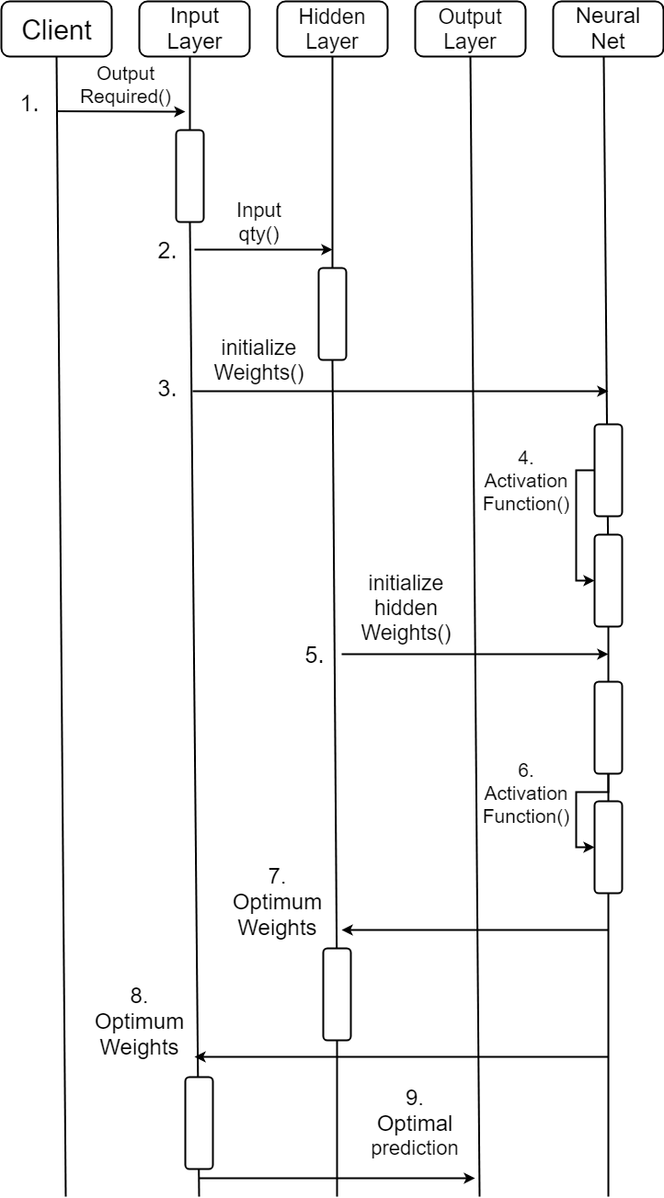
Sequence
Diagram

Slide 13
Diagrams Hyperlink
Data Flow Diagram-0
Data Flow Diagram-1
Entity-Relation Diagram
Activity Diagrams
Architectural Diagram

Slide 14
Proposed Algorithms

Slide 15
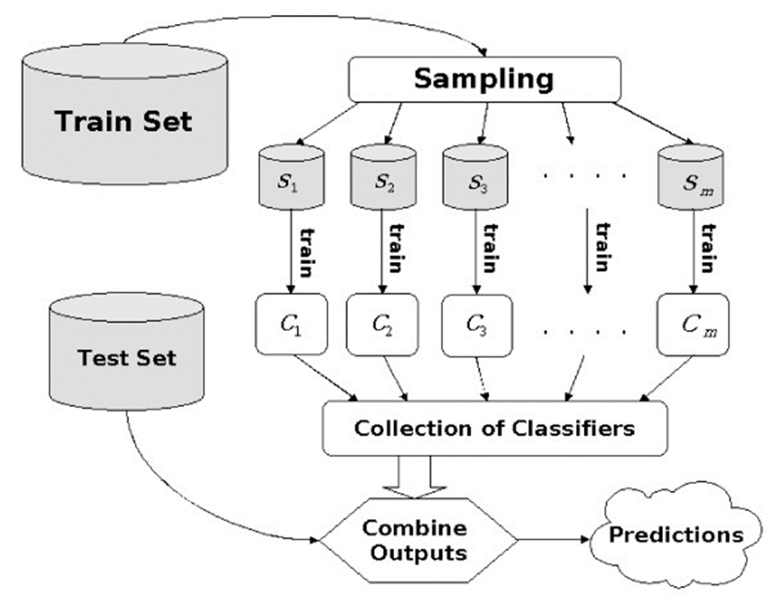
Support Vector Machine

Slide 16
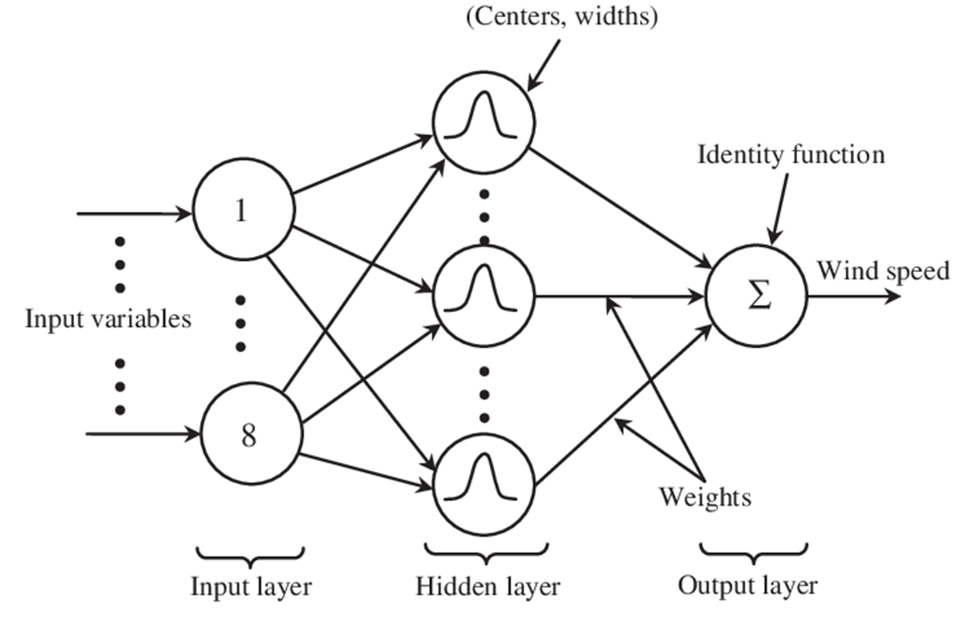
Radial Basis Function

Slide 17
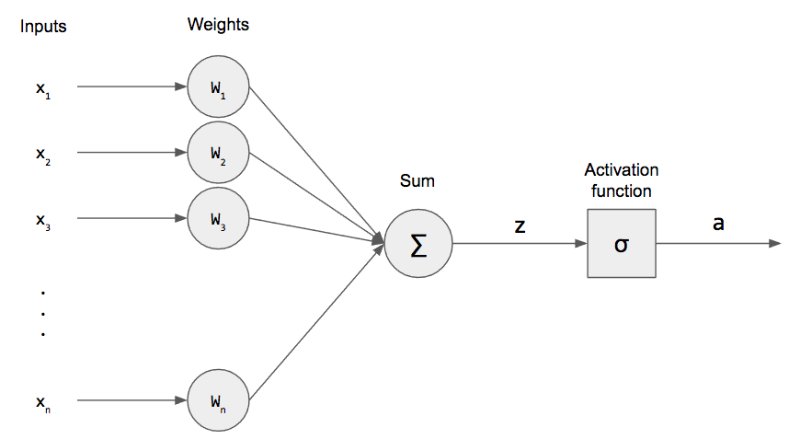
Single Level Perceptron

Slide 18
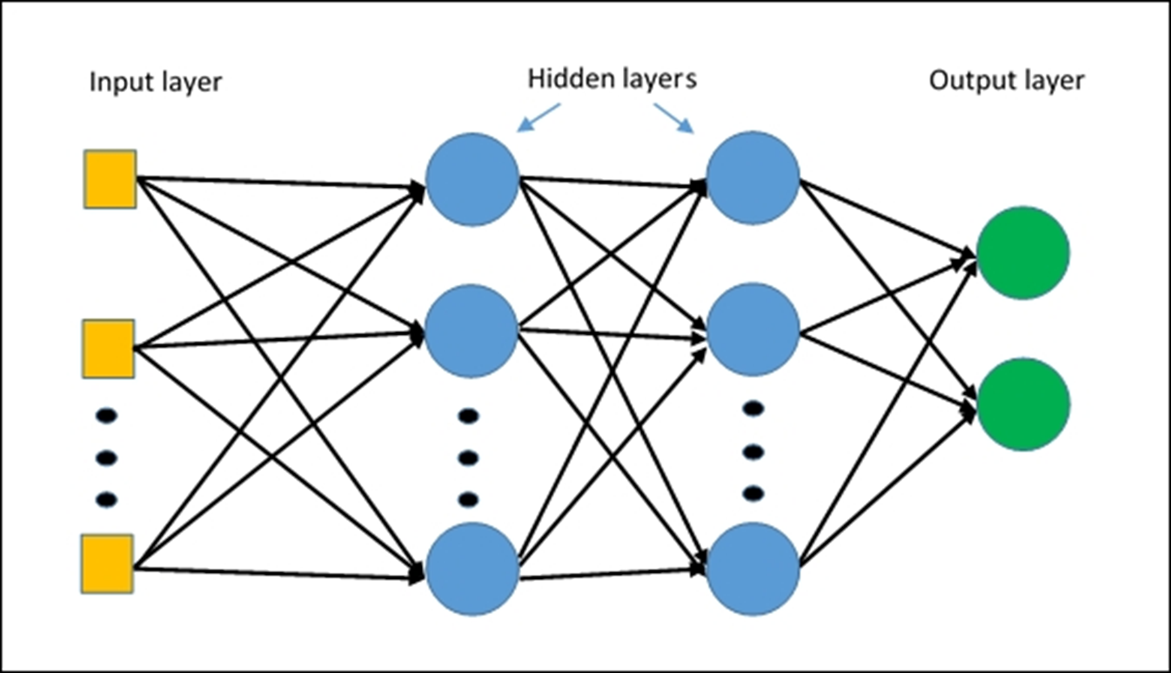
Multi Level Perceptron

Slide 19
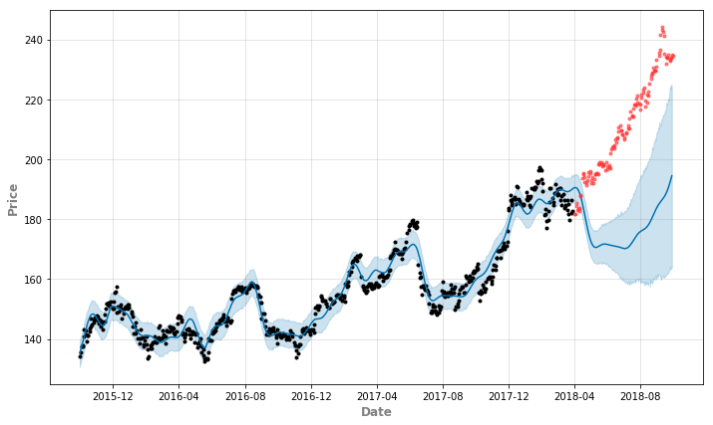
Fbprophet

Slide 20
Requirements
Hardware Requirements
GPU: Nvidia GTX1080
Processor-Intel Core i5
RAM 16GB
Minimum database space: 10GB
Software Requirements
IDE: Jupyter Notebook
Programming Language: Python 3.6.1
Data source: MS-Excel,Live Data
User Interface: GUI Library in Python 3.6.1
Libraries : Pandas, Numpy, sklearn

Slide 21
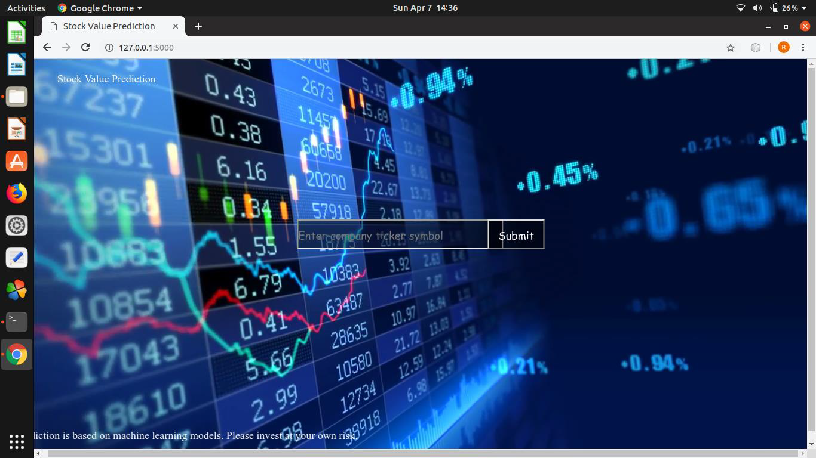
Results -

Slide 22
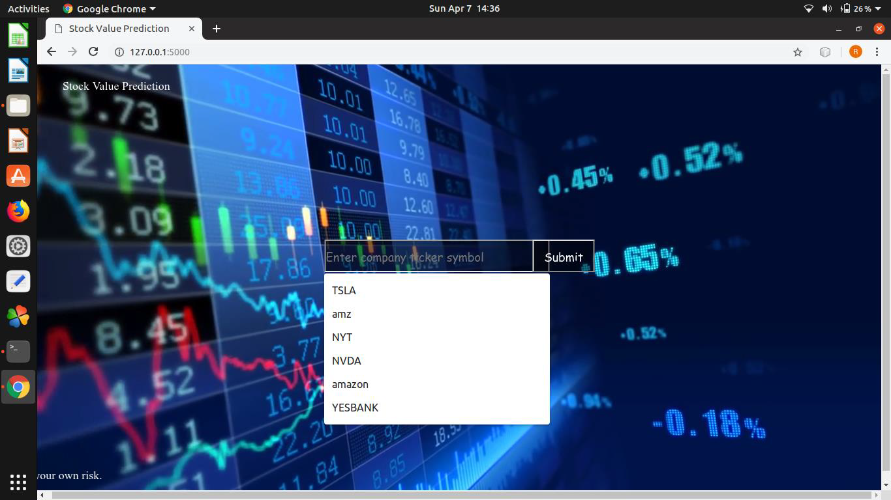

Slide 23
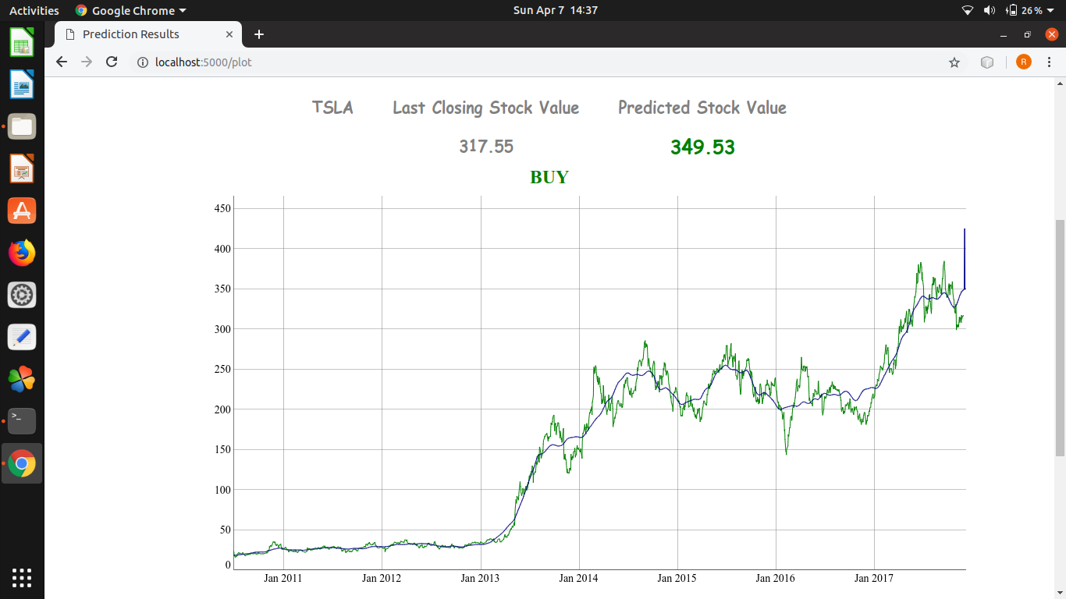
FbProphet

Slide 24
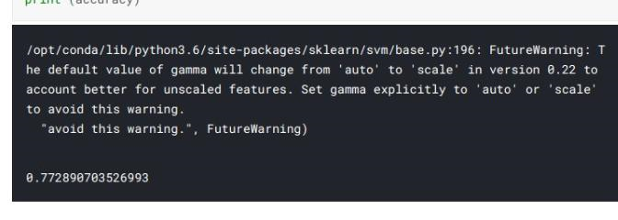
SVM accuracy

Slide 25
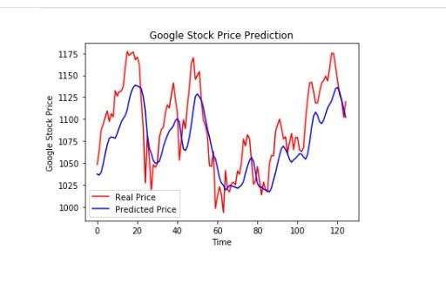
Radial Bias

Slide 26
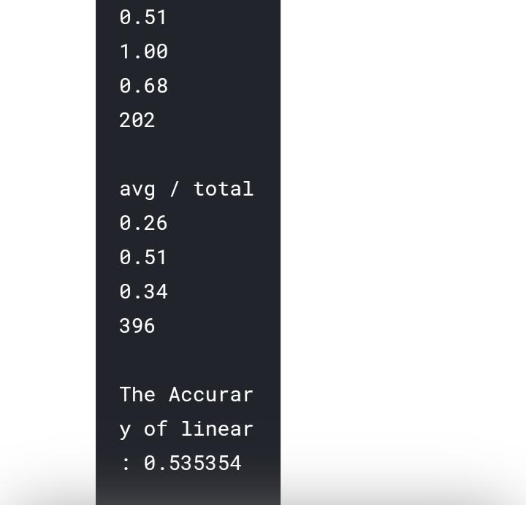
Perceptron

Slide 27
Advantages
uses five Machine learning algorithms to decide which is the most accurate
dig through a lot of data to predict the stock price.
A reliable and accurate program

Slide 28
Limitations
does not take into account various external factors
may not work with the current trends of the market.

Slide 29
Conclusion
Determining the Stock market forecasts is always been challenging work for business analysts.
Attempted to make use of huge textual data
The current system can update its training set as each day passes so as to detect newer

Slide 30
Future Work
Model Updating Frequency
Explore More Algorithms
Improve Feature Extraction
Utilize Time Series Information

Slide 31
Publication
Title : Stock Market Prediction Using Machine Learning
Journal Name : ICINC Sinhgad 2019

Slide 32
References
1- Johan Bollen,Huina Mao, Xiao-Jun Zeng “Twitter mood predicts the stock market.”
2- Xingyu Zhou , Zhisong Pan , Guyu Hu , Siqi Tang, and Cheng Zhao1,2 Stock Market Prediction on High-Frequency Data Using Generative Adversarial Nets
3- Raut Sushrut Deepak 1 , Shinde Isha Uday 2,Dr. D. Malathi 31,2B.Tech Student
SRM University, Kattankulathur, Chennai. - MACHINE LEARNING APPROACH IN STOCK MARKET PREDICTION
4- Ritu Sharma1, Mr. Shiv Kumar2, Mr. Rohit Maheshwari3 - Comparative Analysis of Classification Techniques in Data Mining Using Different Datasets
5- Andrew W. Lo, A. Craig MacKinlay “NATIONAL BUREAU OF ECONOMIC RESEARCH
STOCK MARKET PRICES DO NOT FOLLOW RANDOM WALKS: EVIDENCE FROM A SIMPLE SPECIFICATION TEST”
6- Prof. S .P. Pimpalkar, Jenish Karia, Muskaan Khan, Satyam Anand, Tushar Mukherjee
Department of Computer Engineering, AISSMS IOIT,- Stock Market Prediction using Machine Learning
7- Osman Hegazy - Faculty of Computers and Information Cairo University and Omar S. Soliman Cairo University - A Machine Learning Model for Stock Market Prediction
8- Yash Omer Department , Nitesh Kumar Singh of Information Technology Bharati Vidyapeeth University, College of Engineering - Stock Prediction using Machine Learning

Slide 33

THANKS!
Presentation By
Rushikesh Khamkar
Rushikesh Kadam
Moushmi Jain
Ashwin Gadupudi

